Slide 1

Presenting with Impact
© Apropos Productions Ltd.
Contact: info@aproposltd.com
www.aproposltd.com
Please be aware that this slideshow is given to you for free and cannot be used for commercial purposes. Also some images may be subject to a license fee.

Slide 2
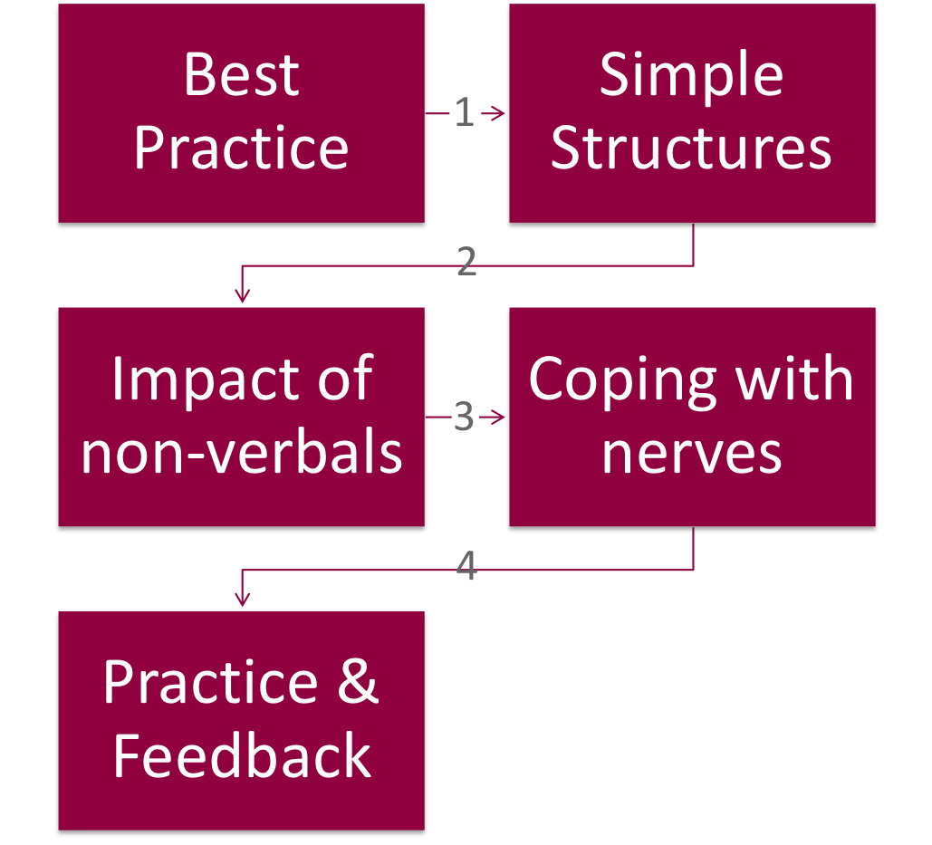
OBJECTIVES

Slide 3
Introductions
Full name:
Any known meanings? Why you were given your first name?
Born & Now Live:
Interesting facts? Why have you moved or stayed?
Professional Background:
    Your role in the company?
    Any presenting experience?
Objectives:
    Areas of interest for today? Key learning areas?
Exercise

Slide 4
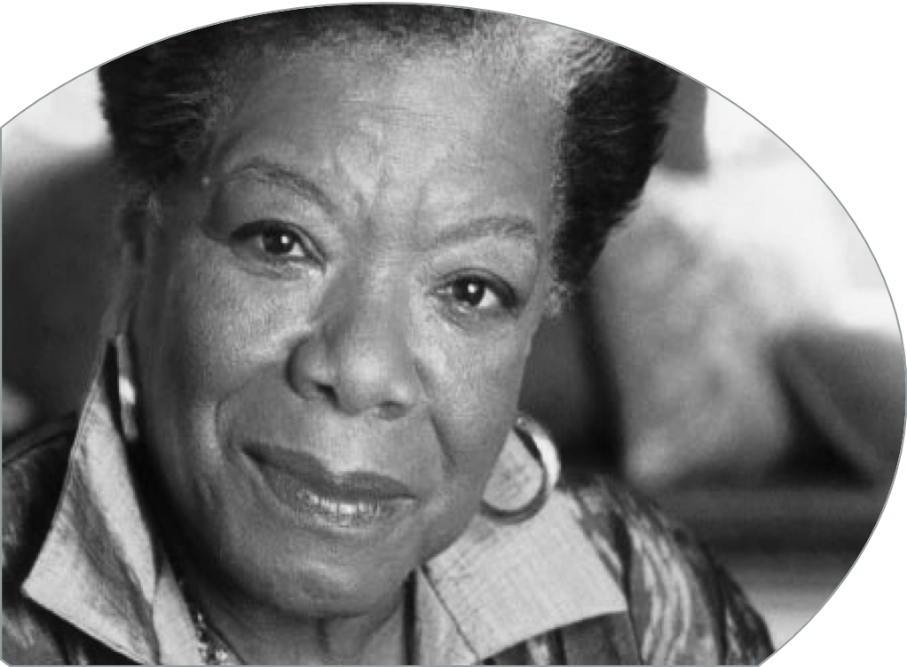
How do they feel about you? How do feel about them?
I’ve learned that people will forget what you’ve said, people will forget what you did.
But people will never forget how you made them feel.
Dr. Maya Angelou

Slide 5
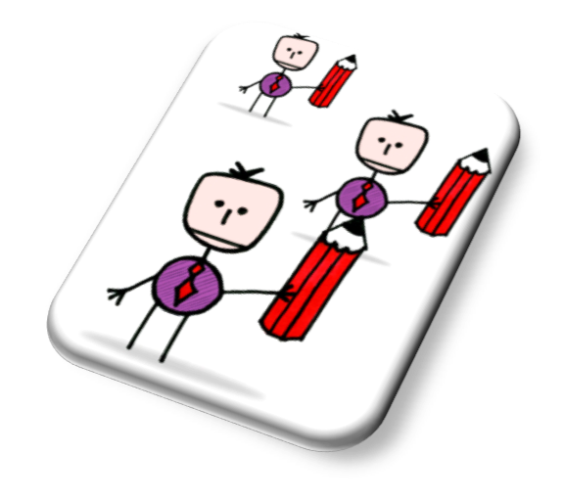
What do
you like?
BETTER PRACTICE

Slide 6


Good & Bad
Group
Work
Things you love?
Things you hate?

Slide 7
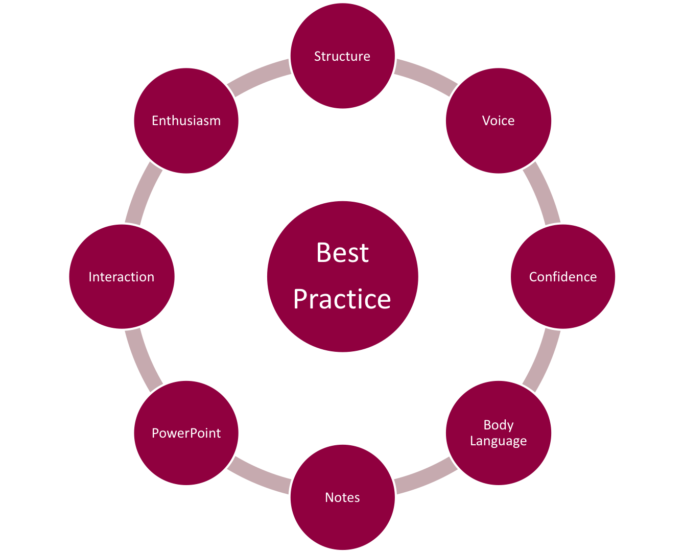
Common
Topics

Slide 8
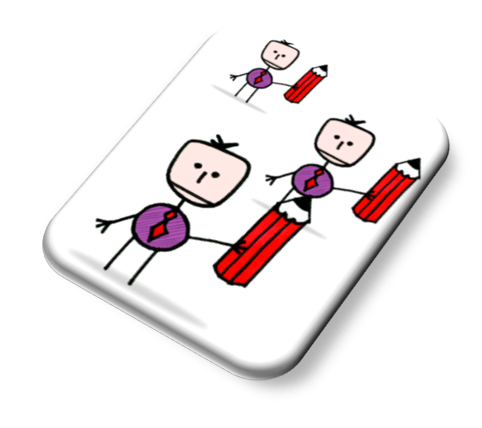
What you say
& how you
say it!
NON-VERBALS & VISUALS

Slide 9
Impact on others: face to face
Mehrabin
Study
UCLA
Notes:
9
Professor Emeritus of Psychology, UCLA. Mehrabian's work featured strongly (mid-late 1900s) in establishing early understanding of body language and non-verbal communication. List of Publications: http://www.kaaj.com/psych/pub.html
When incongruent: meaning the message and the emotional intention of the speaker are NOT aligned!
People will notice your body language and vocal qualities rather that listening to the words.
Professor Mehrabian (1939-) believes that there are three core elements in the effective face-to-face communication of emotions or attitudes: nonverbal behaviour (facial expressions, for example), tone of voice, and the literal meaning of the spoken word. These three essential elements, Mehrabian argues, account for how we convey our liking, or disliking, of another person. His particular focus is on the importance of such nonverbal ‘clues’ when they appear to conflict with the words used and/or the tone in which they are spoken. Mehrabian developed his early theories on this subject during the 1960s. Drawing on the findings of two experiments he conducted in 1967, he formulated the 7-38-55% communication rule.
Life and career
Born in Iran, Mehrabian began his academic studies in the discipline of engineering. Receiving first a Bachelor’s and then a Master’s degree in engineering from the Massachusetts Institute of Technology (MIT), Mehrabian completed his academic achievements with a PhD awarded by Clark University. Following his educational achievements, in 1964 he took up a teaching and research post at the University of California, Los Angeles (UCLA) where he is currently
Professor Emeritus of Psychology.
Entering the discipline of psychology from an engineering background would prove to stand Mehrabian in good stead. Schooled in a subject grounded in hard evidence and testable theories, Mehrabian understood the importance of substantiating his theories and experiments with trusted formulae and measures. Consequently, he has spent much of his career developing scales to quantify and describe complex psychological data.
Key works by Albert Mehrabian
Books
Nonverbal communication. Piscataway, NJ, Aldine Transaction, 1972
Silent messages: implicit communication of emotions and attitudes. 2nd ed. Belmont, Calif., Wadsworth, 1981
(Originally published in 1971)
Journal articles
The Mehrabian myth. Training Journal, November 2008, p.34
Pleasure-arousal-dominance: a general framework for describing and measuring individual differences in temperament. Current Psychology, 14 (4) Winter 1996, pp.261-292
Key works by others
Forrest, C. How to say no. Training Journal, November 2008, pp.32-35

Slide 10
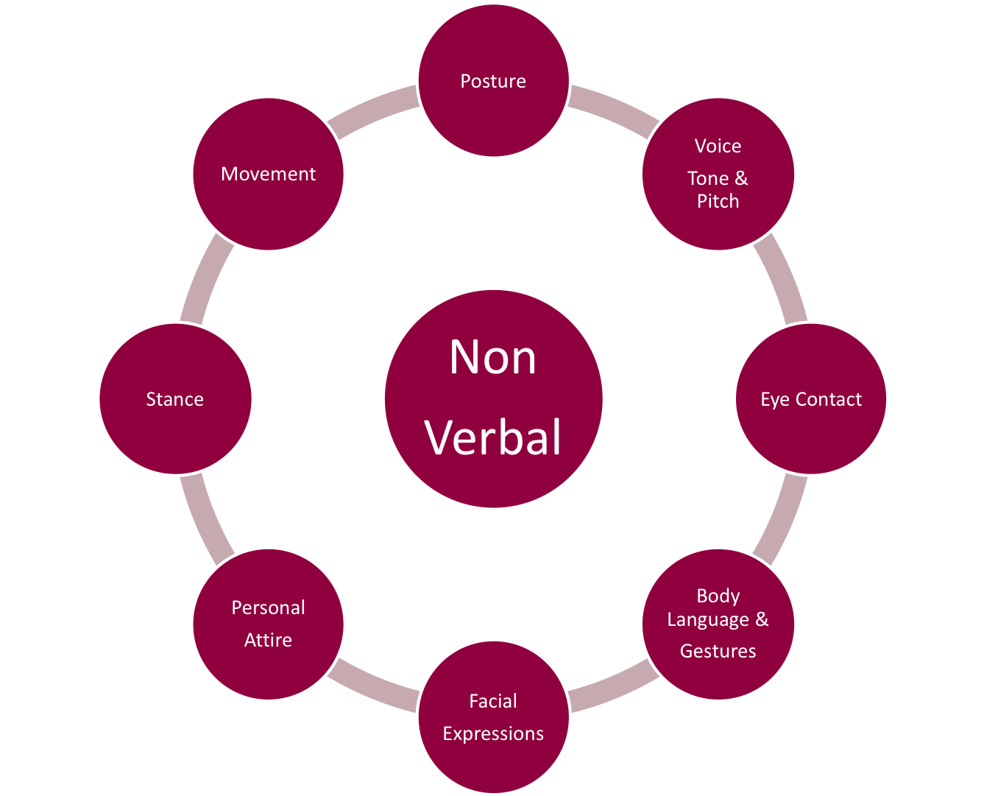
55%
Visual
38%
Vocal

Slide 11
Death
By
PowerPoint
VISUALS

Slide 12
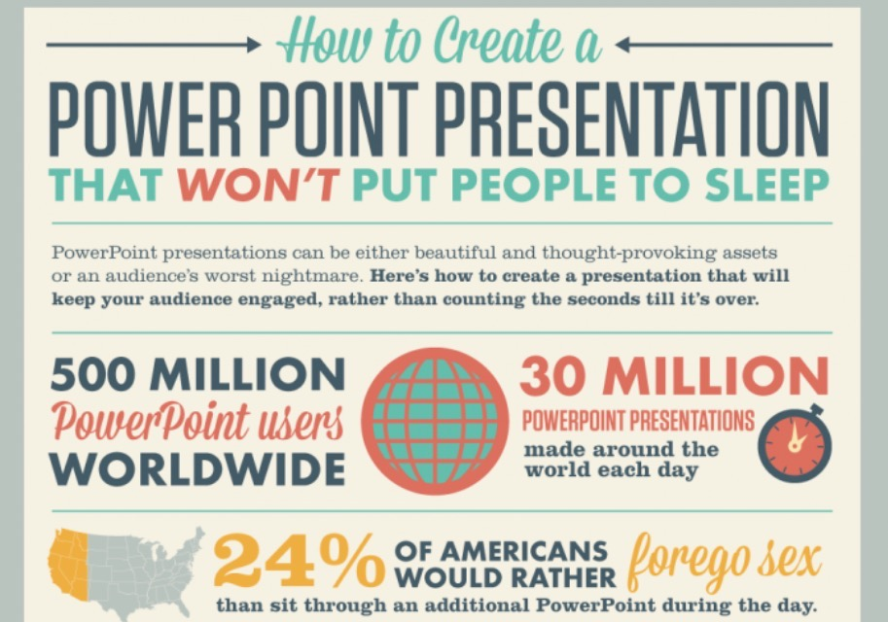

Slide 13
Visual Verbal
Data
Dump
Constructed by Emperor Shah Jahan
Started to be built in 1631, completed in 1653
20,000 people worked on the building
Long watercourse reflecting the building
White minarets grace each corner of the platform
Best to view in the morning or at sunset

Slide 15
IAN IS FORTY TWO YEARS OLD
IAN WORKS AS A CARPENTER IN A FACTORY THAT MAKES HANDMADE FURNITURE
HE HAS WORKED IN THE FACTORY FOR TWENTY THREE YEARS
HE DRIVES A VERY OLD MERCEDES CAR , IT IS A CONVERTIBLE WITH LEATHER SEATS
HE LOVES TO GO ON HOLIDAY TO FRANCE AS HE HAS A REAL PASSION FOR WINE!
HE LOVES HISHIS WORK BECAUSE HE IS ABLE TO START AND FINISH A PIECE OF
WORK SO THERE IS LOTS OF JOB SATIFACTION AND PRIDE
HE IS MARRIED TO HIS WIFE GERALDINE AND THEY HAVE TWO DAUGHTERS CALLED NATASHA AND ELLA WHO ARE FIFTEEN YEARS OLD AND THIRTEEN YEARS OLD
HIS FAVOURITE FOOD IS IS ITALIAN FOOD SUCH AS PASTA AND HE REALLY ENJOYS COOKING IT HIMSELF AS A WAY OF RELAXING AT THE WEEKEND

Slide 16

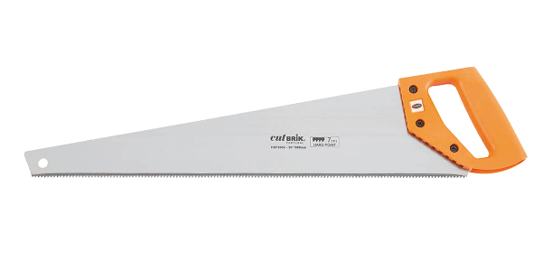

All About Ian
Carpenter in factory 23 years
Age 42
Loves job – satisfaction and pride
Mercedes old – leather seats!
Wife – Geraldine
Daughters - Natasha 15 & Ella 13
Holidays – loves France and wine!
Cooking - Italian food

Slide 17
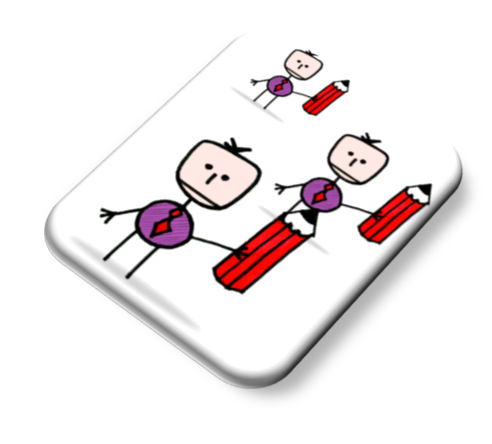
Ian’s Story?
What do
you
remember?
KEY FACTS?

Slide 18

10 slides
20 min
30 pt. font
The Guy Kawasaki Way
10-20-30 rule
Notes:
BOOKS: The Art of the Start 2.0
Guy Kawasaki is the chief evangelist of Canva, an online graphic design tool. He is a brand ambassador for Mercedes-Benz and an executive fellow of the Haas School of Business (UC Berkeley). He was the chief evangelist of Apple and a trustee of the Wikimedia Foundation. He is also the author of The Art of the Start 2.0, The Art of Social Media, Enchantment, and nine other books. Kawasaki has a BA from Stanford University and an MBA from UCLA as well as an honorary doctorate from Babson College.
https://guykawasaki.com/guy-kawasaki/

Slide 19


Slide 20
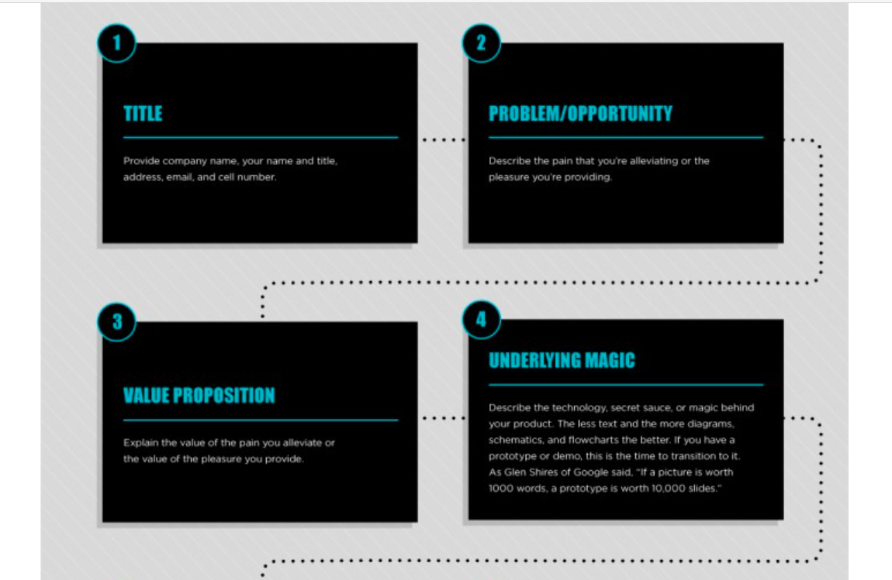

Slide 21
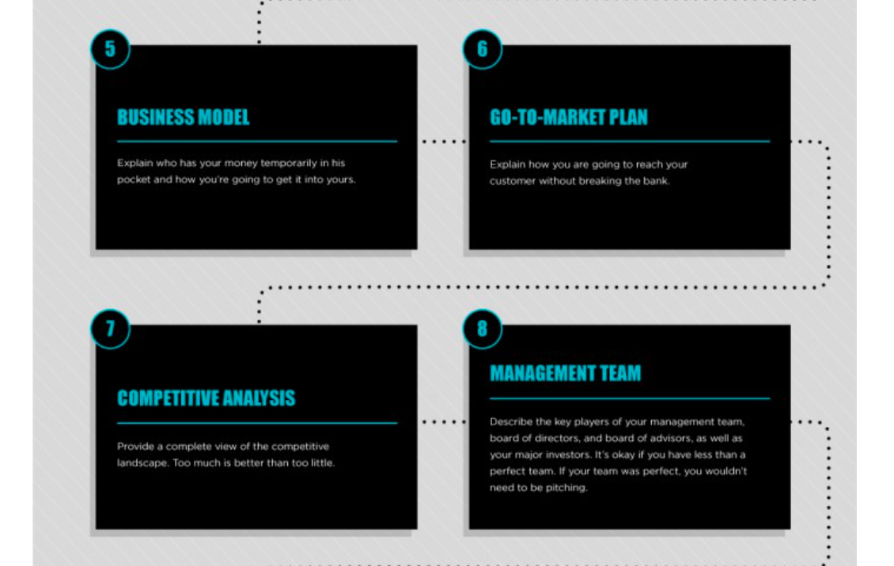

Slide 22


Slide 23
Nerves
are
necessary
NERVES

Slide 24
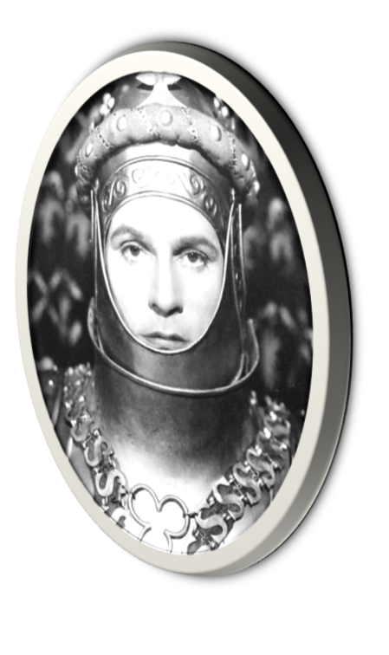
Nerves or Excitement?
Break
a
leg
If you are not nervous, you’re dead
Lawrence Olivier

Slide 25


Slide 26
10 Biggest Fears
Source
WSJ
Voice shaking – breathlessness
Forgetfulness
Technical glitches
Hecklers & saboteurs
Unengaged/bored audience
Audience not understanding content
Phoney-ism: ‘I’m not qualified/experienced’
Being too long/short (timing & content issues)
Someone asking a question I can’t answer
Profuse sweating and/or poor body language
Notes:
Source Toni Wilson

Slide 27
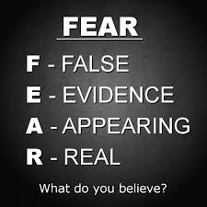
Feel the Fear & Do It Anyway: Jeffers
The fear will never go away as long as you continue to grow.
The only way to get rid of the fear of doing something is to go out and DO IT!
The only way to feel better about yourself is to go out and DO IT!
Not only are you afraid when facing the unknown, so is everyone else.
Pushing through fear is less frightening than living with the bigger underlying fear that comes from a feeling of helplessness.
Notes:
FEAR TRUTH #1
The fear will never go away as long as you continue to grow!
Every time you take a step into the unknown, you experience fear. There is no point in saying, "When I am no longer afraid, then I will do it." You'll be waiting for a long time. The fear is part of the package.
FEAR TRUTH #2
The only way to get rid of the fear of doing something is to go out and…do it!
When you do it often enough, you will no longer be afraid in that particular situation. You will have faced the unknown and you will have handled it. Then new challenges await you, which certainly add to the excitement in living.
FEAR TRUTH #3
The only way to feel better about yourself is to go out and…do it!
With each little step you take into unknown territory, a pattern of strength develops. You begin feeling stronger and stronger and stronger.
FEAR TRUTH #4
Not only are you afraid when facing the unknown, so is everyone else!
This should be a relief. You are not the only one out there feeling fear. Everyone feels fear when taking a step into the unknown. Yes, all those people who have succeeded in doing what they have wanted to do in life have felt the fear - and did it anyway. So can you!
FEAR TRUTH #5
Pushing through fear is less frightening than living with the bigger underlying fear that comes from a feeling of helplessness!
This is the one truth that some people have difficulty understanding. When you push through the fear, you will feel such a sense of relief as your feeling of helplessness subsides. You will wonder why you did not take action sooner. You will become more and more aware that you can truly handle anything that life hands you.
Copyright © 1987-2012 Susan Jeffers, Ph.D. All rights reserved.

Slide 28

Antidotes
Prepare & rehearse
Focus on your message
Mingle & interact with the audience
Breathe & warm up
Drink water
Arrive early
Look at the audience
Memorise your introduction

Slide 29

Areas you can CONTROL: 4Cs
Control: materials
Control: audience
Control: resources
Control: yourself
Notes:
Content
Structure
Clarity
Language
HENRY V speech
Character
Body language: Persona:
Posture Energy
Gesture Dress sense
Facial expression Warmth/authority
Eye contact Invitation
Craft
Vocal qualities
Volume
Voice tone
Rate of speed
Diction

Slide 30
Let’s get
physical
WARM UP

Slide 31
Consonants for Clarity
Say
aloud
I saw Susie sitting in a shoe-shine shop. All day long she shines and sits and shines and sits. I saw Susie sitting in a shoe-shine shop.
Round and round the rugged rocks the ragged rascal ran.
Unique New York, New York’s unique.
The sixth sick sheik’s sixth sheep’s sick.
Betty Botter bought a bit of bitter butter. Betty Botter thought a bit of better butter should be bought. She bought a better bit of butter, better butter than the bitter butter Betty bought.

Slide 32
Clarity
SIMPLE STRUCTURES

Slide 33
I Want My Audience To…
THINK?
FEEL?
DO?

Slide 34
Shape Of Your Talk
1.
Introduction
4 Sections
2.
Body
*
*
*
3.
Summary
4.
Call to Action

Slide 35

Shape Of Your Talk
Intro

Slide 36
Introduction: simple ABCD
Intro
Attention: greeting, suitable humour, use ‘imagine’
Benefits: get what’s in it for them
Credentials: your experience
Direction: signposting
Move to ‘the body’

Slide 37
EXAMPLE
Intro
Attention - 75% of people have some anxiety around public speaking
Benefits – Today I will be giving you some easy tips to immediately reduce that anxiety
Credentials - I’m a training consultant with many years experience specialising in public speaking
Direction - Over the next 20 minutes I will show you how to structure your talk, and provide methods to engage with your audience, to give you the confidence to present

Slide 38
POP or 3 FFFs
Body
POP
PROBLEM was this…
OPTIONS explored were...
PROPOSAL suggested is this!
3 Fs
I understand how you FEEL....
This organsation/person FELT the same...
What they FOUND was...

Slide 39
Position – Reason – Example - Proposal
Body
Position: Women are men’s equals
Reason: Little a man can do which women cannot
Example: Astronauts, Military, Prime Ministers
Proposal: A review of our levels of women in management positions

Slide 40
Making Your Point Powerfully
Body
Point: What’s important is X
Story: Quick anecdote/example
Point: So what this means is…

Slide 42
Your
Turn
PRACTICE & FEEDBACK

Slide 43
Re-Cap Session & Action Plan?
Take
Away?
Best Practice
Simple Structures
Impact of non-verbals
Coping with nerves
Practice & Feedback

Slide 44

Presenting with Impact
Apropos Productions Ltd.
info@aproposltd.net
www.aproposltd.net

